Slide 1

Data Driven Applications
Web Applications
Data Access – PHP and MySQL
Cookies, Sessions & user Authentication
Lecture 4

Slide 2
Learning Outcomes
You will be able to :
Explain what cookies are, how they persist and how they are used (set /unset etc)

Slide 3
Setup
Make sure your Apache server is running – check your XAMPP control panel
In your htdocs folder make sure there is a subfolder for this topic
Eg ..C:/xampp/htdocs/K00999999/T02
Download and unzip the code for this lecture to this folder
Restore the database from the project /database folder
Start NETBEANS
Open the TWO netbeans projects for this lecture at this location

Slide 4
3 Projects
L04_COOKIES
This project contains examples of how to set, view and unset cookies in a client browser.
L04_SESSIONS
This project contains simple examples to illustrate how session variables can be used to support user logon and logoff
L04_MVC_SESSIONS
This project is an MVC application in which different classes of user (administrator, lecturer, student) can LOGIN/OUT using session variables to control page access.

Slide 5
Cookies
A cookie is a small file that the web server saves on the user's computer.
Each time the same computer requests a page with a browser, it will send the cookie too.
With PHP, you can both create and retrieve cookie values.

Slide 6
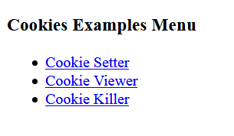
L04_COOKIES Examples - Cookie Setter, Viewer, Killer
This example enables exploration of cookies and how they work

Slide 7
How to create a cookie
The setcookie() function is used to set a cookie.
setcookie() defines a cookie to be sent along with the rest of the HTTP headers. Like other headers, cookies must be sent before any output from your script (this is a protocol restriction). This requires that you place calls to this function prior to any output, including <html> and <head> tags as well as any whitespace.
Syntax (see notespage)
setcookie(name,value,expire,path,domain,secure,httponly);
Returns bool true or false
Example – see - controller_cookie_manager.php
<?php setcookie("user", "Gerry", time()+3600);
setcookie("shortlife","Data Driven Applications",time()+10);
?>
Notes:
name
Required. Specifies the name of the cookie
value
Optional. Specifies the value of the cookie
expire
Optional. Specifies when the cookie expires. The value: time()+86400*30, will set the cookie to expire in 30 days. If this parameter is omitted or set to 0, the cookie will expire at the end of the session (when the browser closes). Default is 0
path
Optional. Specifies the server path of the cookie. If set to "/", the cookie will be available within the entire domain. If set to "/php/", the cookie will only be available within the php directory and all sub-directories of php. The default value is the current directory that the cookie is being set in
domain
Optional. Specifies the domain name of the cookie. To make the cookie available on all subdomains of example.com, set domain to "example.com". Setting it to www.example.com will make the cookie only available in the www subdomain
secure
Optional. Specifies whether or not the cookie should only be transmitted over a secure HTTPS connection. TRUE indicates that the cookie will only be set if a secure connection exists. Default is FALSE
httponly
Optional. If set to TRUE the cookie will be accessible only through the HTTP protocol (the cookie will not be accessible by scripting languages). This setting can help to reduce identity theft through XSS attacks. Default is FALSE

Slide 8
Cookies Persist
Cookies stay on the client machine as long as they have not expired or have not been deleted on the client machine.
Every time a browser requests a page from a web server – it sends a copy of all cookies received from that server.
On the server side – cookies are stored in a superglobal array called $_COOKIE
The name of the cookie in the $_COOKIE array corresponds with the name of the cookie on the client machine as defined by setcookie()

Slide 9

Cookies – where is the data stored?
Cookies stored on client machine as individual files
Client
Browser
Application
https://support.mozilla.org/en-US/kb/cookies-information-websites-store-on-your-computer
Cookie:user
Cookie:shortlife
Internet
$_COOKIE
Array contains copies of cookies sent from the client machine when a web page is requested
Web Server
$_COOKIE[‘user’]
$_COOKIE[‘shortlife’]

Slide 10
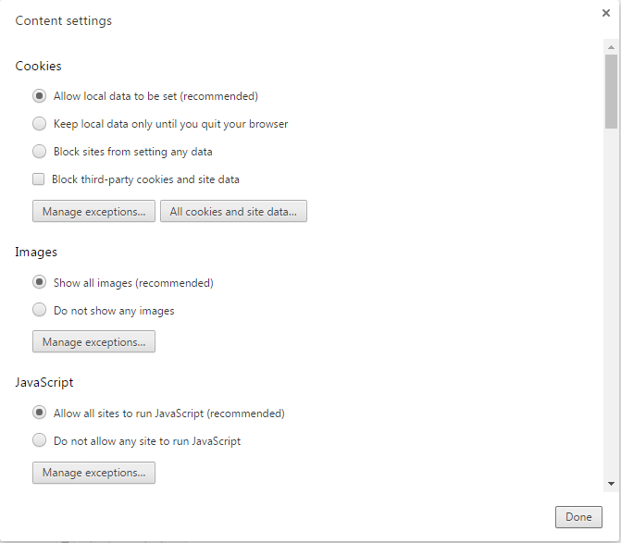
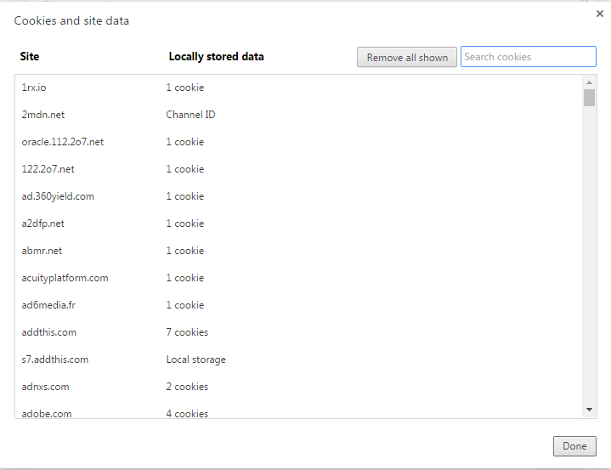
Show cookies in Chrome
Open Chrome->settings->advanced
Then select Privacy->Content Settings->Cookies and Site Data

Slide 11

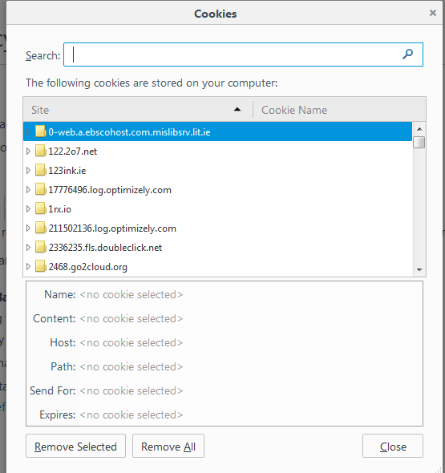
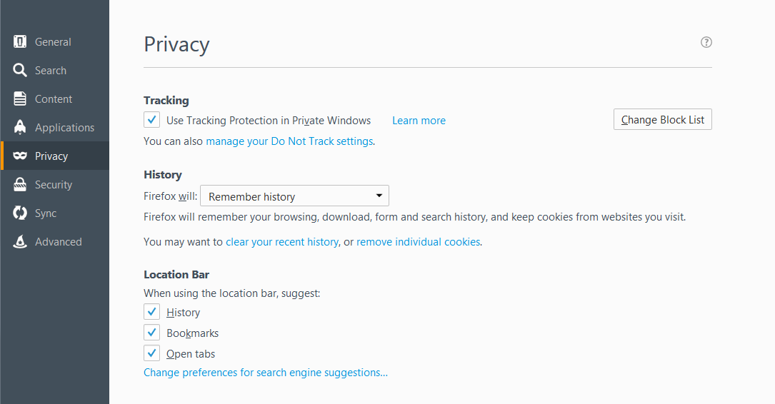
Show cookies in Firefox
Open settings->
Then select Privacy->History->Remove Individual Cookies

Slide 12
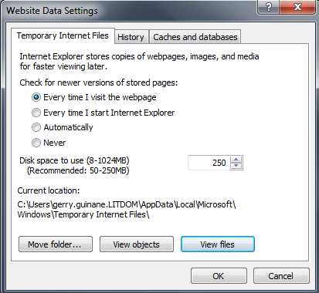
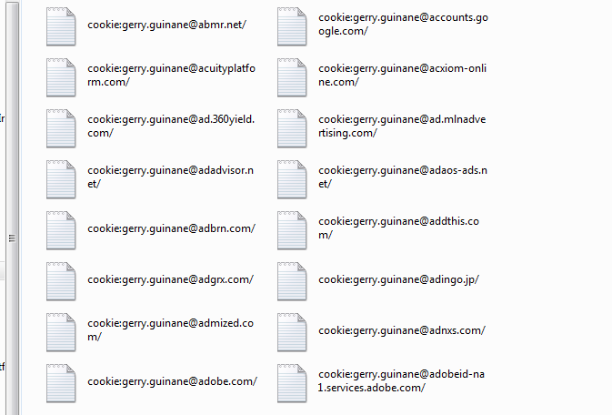
Show cookies in IE
Open settings->internet options
Then select Browsing History->Settings->View Files

Slide 13
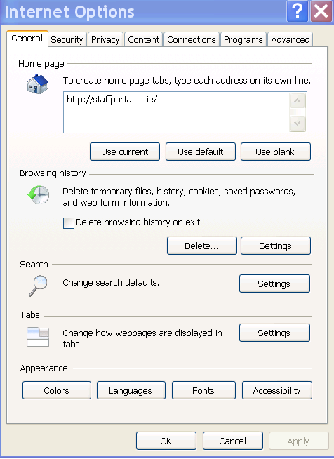
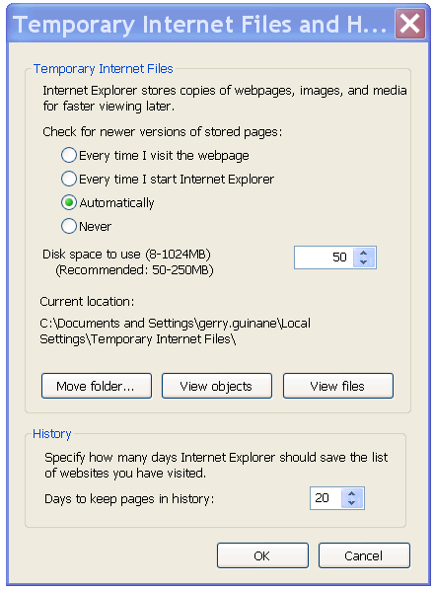
View Cookies IE

Slide 14
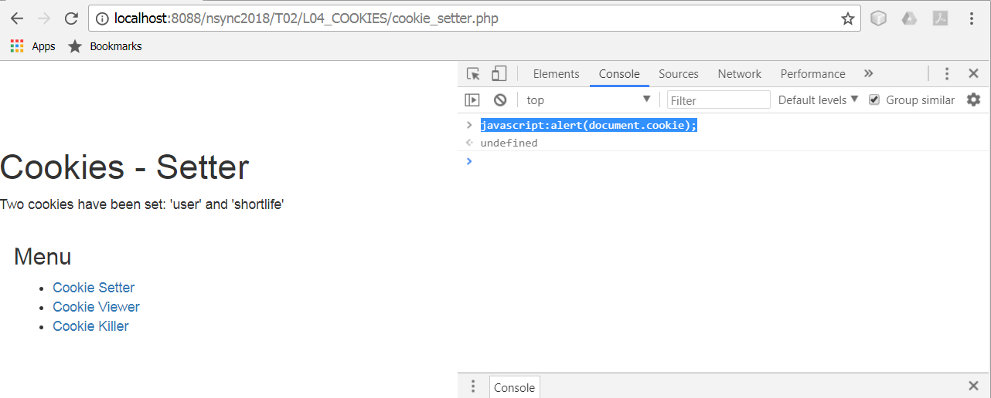
Browser Developer mode - console
To view cookies - In all of these browsers you can open developer mode (Ctrl-Shift-J) – select the console and type javascript:alert(document.cookie);

Slide 15
Example 01 - Cookie Setter
The setcookie() function must appear BEFORE the <html> tag.
<?php
//Set a cookie
//
setcookie("user", “Gerry", time()+3600);
setcookie("shortlife","Data Driven Applications",time()+10);
?>

Slide 16
Example 02 - Cookie Viewer
if (isset($_COOKIE["user"]))
{
//Check that the cookie value is set
echo "The <b>user</b> Cookie value is : ".$_COOKIE["user"];
}
else{echo "The <b>user</b> cookie has expired or has not been set";}

Slide 17
Example 03 - Cookie Killer
Kill a cookie by setting a negative time
<?php
//EXAMPLE - UN-SETTING COOKIES
setcookie("user", "", time()-10;
setcookie("shortlife","",time()-10);
?>

Slide 18
Explore the mechanics of cookies
Set and unset cookies using PHP
Close and open browser
Hit the BACK button
Reload the page
Close browser – open page in a different browser
Clear browser cache
Delete Browser cookies

Slide 19
Problem with COOKIES
Cookies are stored on the client PC
They may be changed by the client PC user
Other users on the client PC may access websites using someone else’s cookies if they havn’t expired – eg in an internet cafe
Solution is SESSIONS

Slide 20
SESSIONS
SESSION DATA are similar to cookies BUT stored on the SERVER rather than the client PC
A SESSION is established between a client and the server using a unique session number
The unique session number is stored on the client PC as a cookie called PHPSESSID
SESSION data is stored in the $_SESSION array on the server
SESSIONS may be made to expire for example when a user logs out thus preventing their data being visible to other users on the same PC

Slide 21
Sessions – where is the data stored?
Cookies stored on client machine as individual files
Client
Browser
Application
Cookie:PHPSESSID
When a session is established between a browser and web server then the web server sends a cookie – PHPSESSID to the browser.
Each further page request from the browser includes the PHPSESSID cookie
The server maintains an array $_SESSION to contain the variables used by the web application for EACH session
Internet
$_COOKIE[‘PHPSESSID’]
Web Server
$_SESSION[‘views’]
$_SESSION[‘login’]

Slide 22
Session Persistence
Generally sessions will persist on both the browser and server machines.
On the browser side – the session ID is saved in the cookie PHPSESSID
On the server side the session data is saved in a file. The location of the file can be found by calling session_save_path()
This means that if the server and/or the browser are shut down and restarted – the session may be resumed.
This is a major security risk for logged on users if sessions are not properly killed.
http://php.net/manual/en/book.session.php

Slide 23
L04_SESSIONS Examples
session_set – This example JOINS a session and sets a variable to count the number of page views
session_view – This example displays the $_COOKIE and $_SESSION array contents. Each time the page is reloaded the $_SESSION[‘pageviews’] session variable is incremented
session_unset – unsets and destroys all session variables and destroys the client side session cookie
loginout – uses a simple login button to create a session variable which is used to control access to a private web page

Slide 24
Set up a session
Any page joining a session must have session_start() before the <html> tag:
<?php
session_start(); //attach this page to the current session or create a new session
//initialise session variables
if(!isset($_SESSION['pageviews'])){
$_SESSION['pageviews'] = 1;
}
else{
$_SESSION['pageviews']++;
}
?>
At least one session variable is set up which can be used to manage the session in subsequent pages – in this case:
$_SESSION[‘pageviews']
This will be stored on the SERVER and accessible to any page that joins the session using unique the session ID
See: session_set.php

Slide 25
Unset a session
See: session_unset.php
Kills the session and the session variables
Kills the cookie on the client machine containing the session ID
<?php
session_start(); //attach this page to the current session or create a new session
// Unset all of the session variables.
$_SESSION = array();
// If it's desired to kill the session, also delete the session cookie.
// Note: This will destroy the session, and not just the session data!
if (ini_get("session.use_cookies")) {
$params = session_get_cookie_params();
setcookie(session_name(), '', time() - 42000,
$params["path"], $params["domain"],
$params["secure"], $params["httponly"]
);
}
//Delete ALL session variables
session_destroy();
?>

Slide 26
Logging in and out – simple example
The logInOut.php example shows how to process a button click to set a user session variable $_SESSION[‘loggedin’] to TRUE or FALSE
This variable value can then be used by any other page attached to the same session to control access to the page.
This represents a simple login and logout process – just using a button click, no passwords etc are used in this example

Slide 27
protectedPage.php
This page joins a session and then checks if the user is logged on before allowing access to its content
<?php
//check if user is logged in
if($_SESSION['loggedin']===TRUE){
//user is logged in
echo “Welcome – you are logged in”;
}
else{
//user is not logged in
echo “You are NOT logged in”;
}
?>

Slide 28
Logging in using a database
The example up to now just used a simple ‘click’ to login.
No verification of the users identity was used
To verify a users ID:
We can use a simple html form to capture a users ID and password
Compare it with values held in a DB
Permit access if valid credentials are entered
See project L04_MVC_SESSIONS

Slide 29
L04_MVC_SESSIONS
One of the main features of this example is the use of a Session class to manage sessions , logging on and logging off and getting user login status.
index.php (the main application entry point) creates the new Session object and passes it to the main Controller object.
The controller object passes the Session object on to any Model object that it creates
All controller and view actions are based on whether the user has logged on using this class.
The authorisation level of the user is defined at login depending on who is logged in.
The authorisation level is stored as a property of the Session object and is used by the main controller to control what the user is able to do once logged in.

